Slide 1
Autosomal reciprocal translocations

Slide 2
Reciprocal translocation is an exchange of chromosomal material between non homologous chromosomes
Distal portion exchanged is the translocated segment
Rest of chromosome including centromere is the centric segment
Rearranged chromosome is called derivative (der) chromosome
1 person in 500 is a reciprocal translocation carrier (classic cyto)
Translocation may be de novo or run in families

Slide 3
Single segment exchange: one of the translocated segments is very small and comprises only the telomeric cap with the supposition of no genes contained
Double segment exchange: both translocated segments are of substantial size
Whole-arm translocation: rare and involves breakpoint at the centromere with an exchange of entire arms

Slide 4
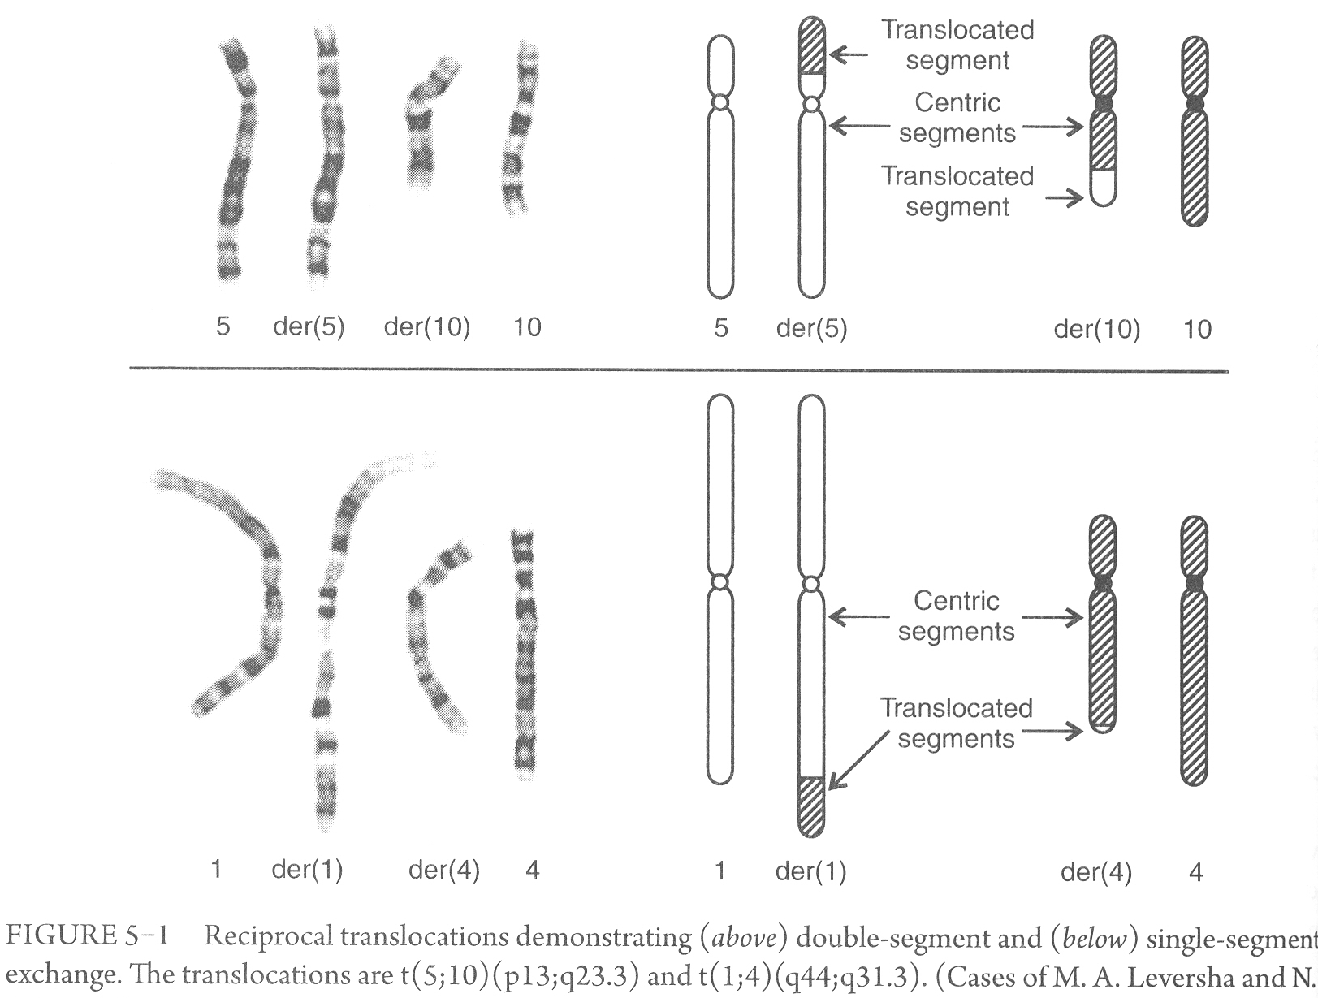

Slide 5
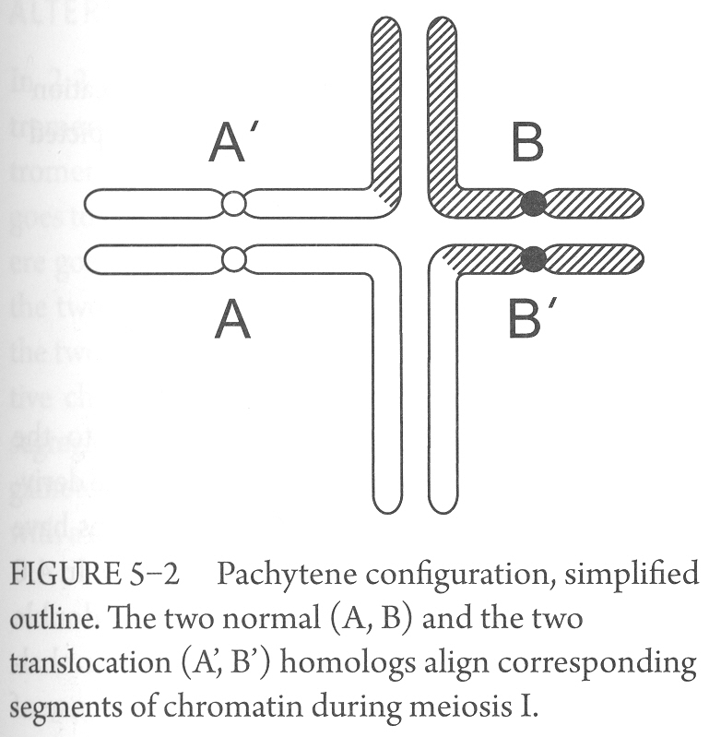
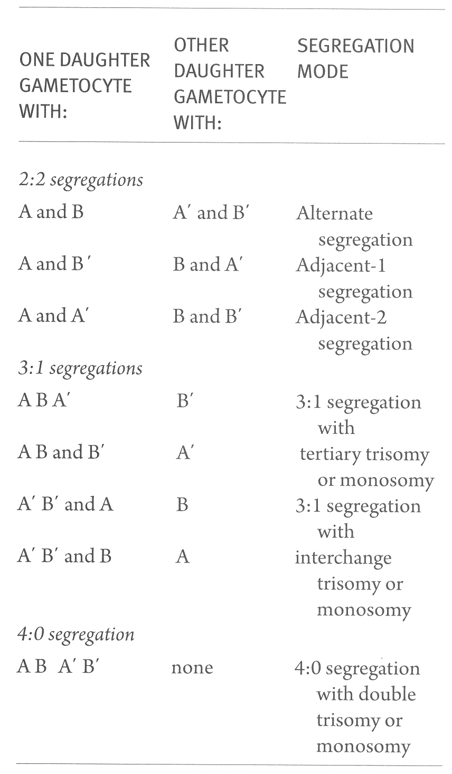
Quadrivalent
Segregation

Slide 6
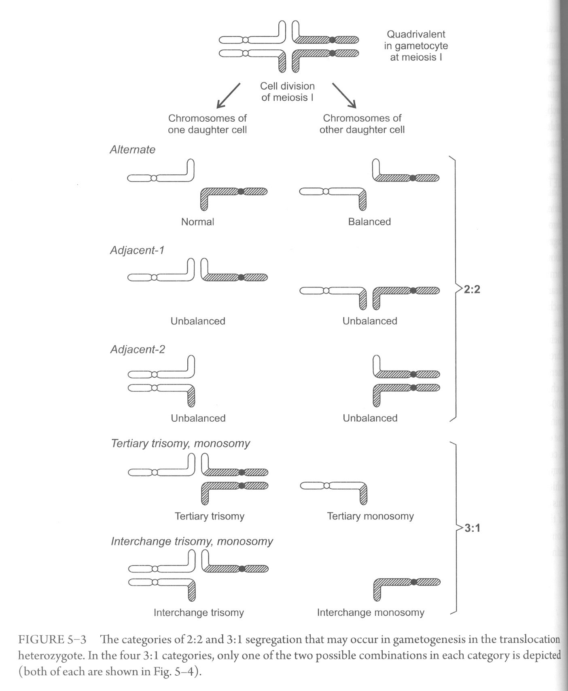

Slide 7
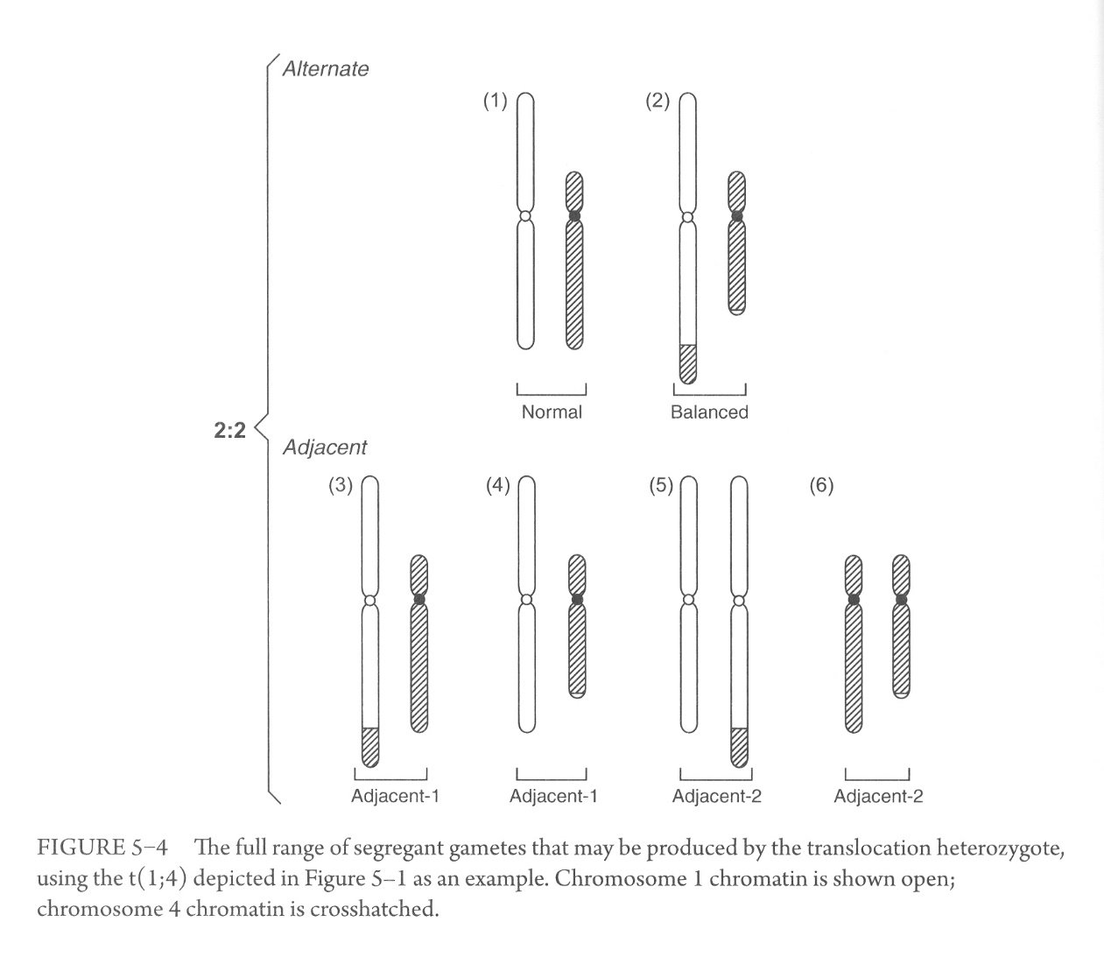
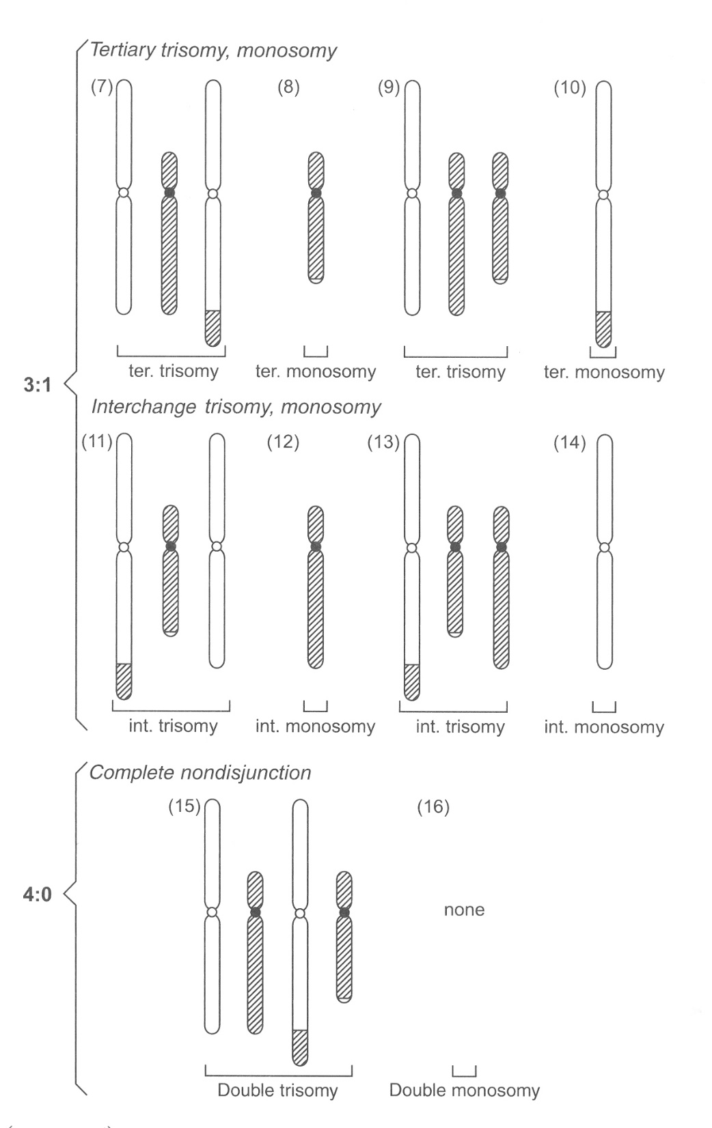
In a review of 1159 translocation families (1994), proportions of chromosomally unbalanced offspring were:
71% adjacent-1
4% adjacent-2
22% tertiary trisomy/monosomy
2.5% interchange trisomy

Slide 8
Gamete studies:
Sperm and oocyte karyotyping for 45 men and 9 women heterozygous for a translocation were:
male female
ALT 44% 30%
ADJ-1 31% 24%
ADJ-2 13% 16%
3:1 11% 27%
4:0 0.4% 2%
Total abn. 56% 70%

Slide 9
Viability in utero
Most unbalanced combinations would produce such an enormous genetic imbalance that the conceptus would be lost very early in pregnancy
Moderate imbalances would proceed to the stage of recognizable miscarriage or to a later fetal death in utero
Only those conceptuses with lesser imbalances might result in the birth of an abnormal child
Viability is much more likely in the case of effective single-segment imbalance

Slide 10
Predicting segregant outcomes:
We assume that alternate segregation is frequent and associated with phenotypic normality
The least imbalanced, least monosomic of the imbalanced gametes is the one most likely to produce a viable conceptus
More, next:

Slide 11
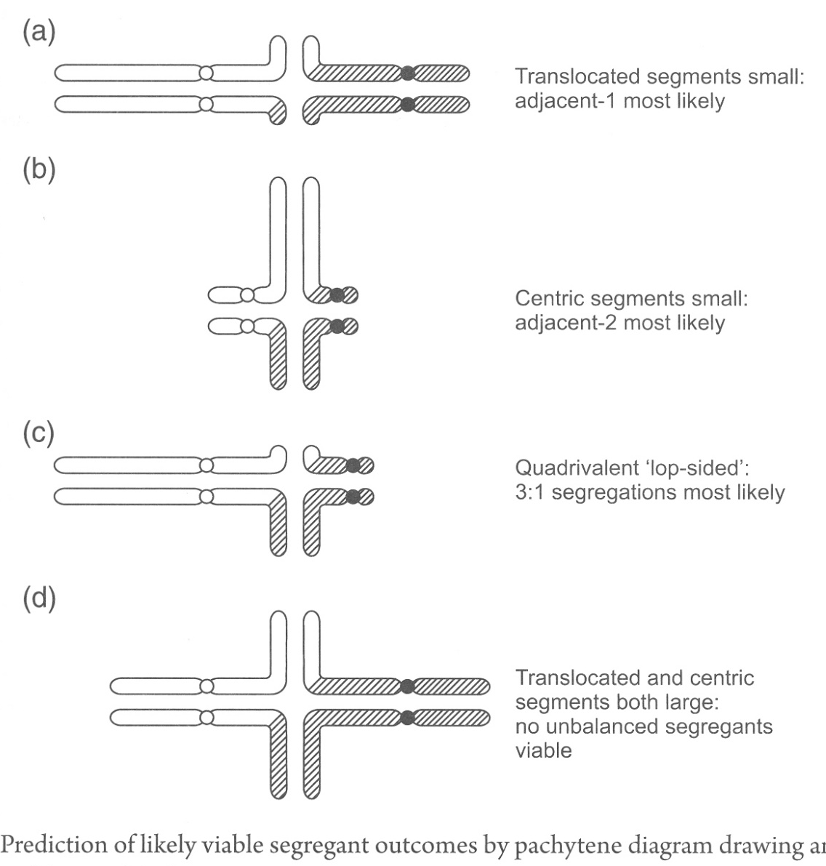
(a) If the translocated segments are small in genetic content, adjacent-1 is the most likely type of malsegregation to be capable of giving rise to viable abnormal offspring
(b) If the centric segments are small in content, adjacent-2 is the most likely segregation to give viable abnormal outcome
(c) If one of the whole chromosomes of the quadrivalent is small in content, 3:1 disjunction is the most likely
(d) If the translocated and centric segments both have large content, no mode of segregation could produce an unbalanced gamete that would lead to a viable offspring
Subtelomeric translocations may not necessarily form a quadrivalent, and the pairs of homologs might simply join up as bivalents, each pair then segregate independently

Slide 12
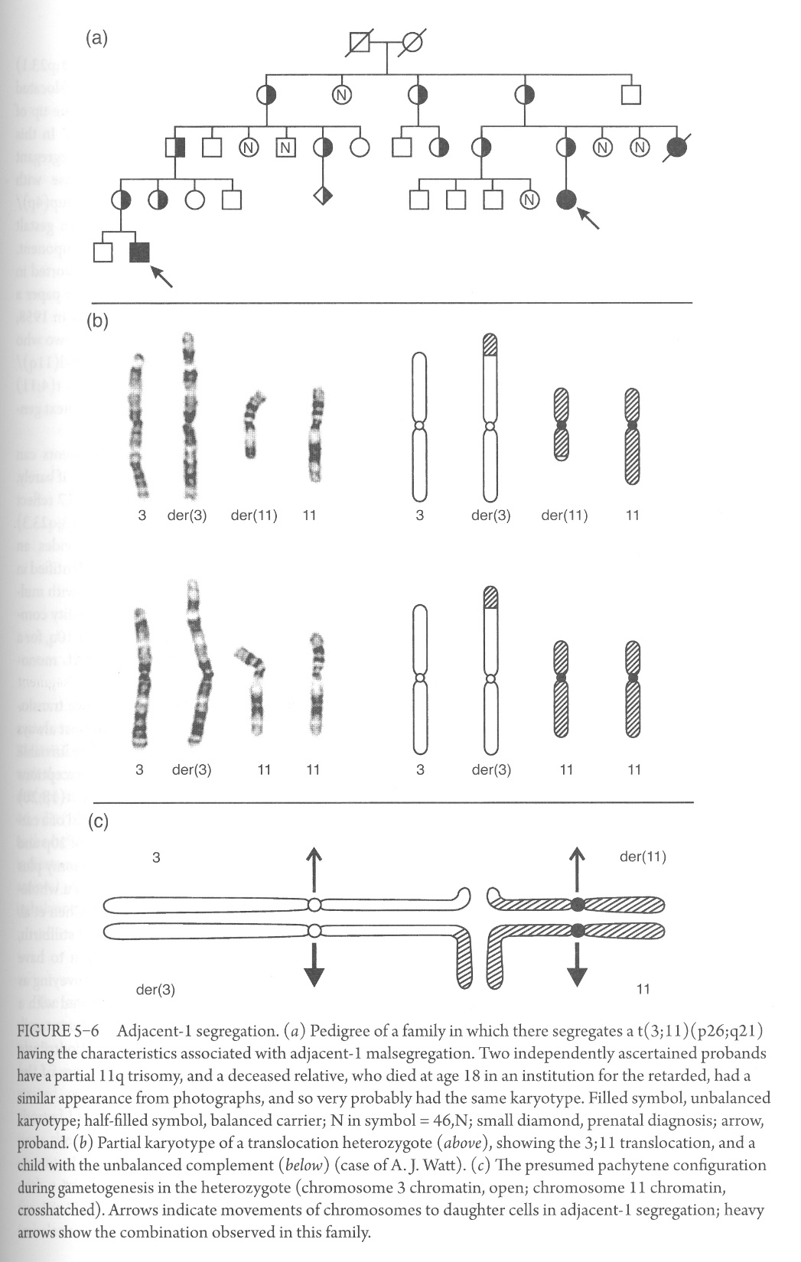
Adjacent-1 segregation, single-segment exchange
The scenario of a single survivable imbalanced form, due to a partial trisomy from adjacent-1 segregation in a single-segment translocation is the most commonly encountered circumstance in translocation families at risk for an abnormal child

Slide 13
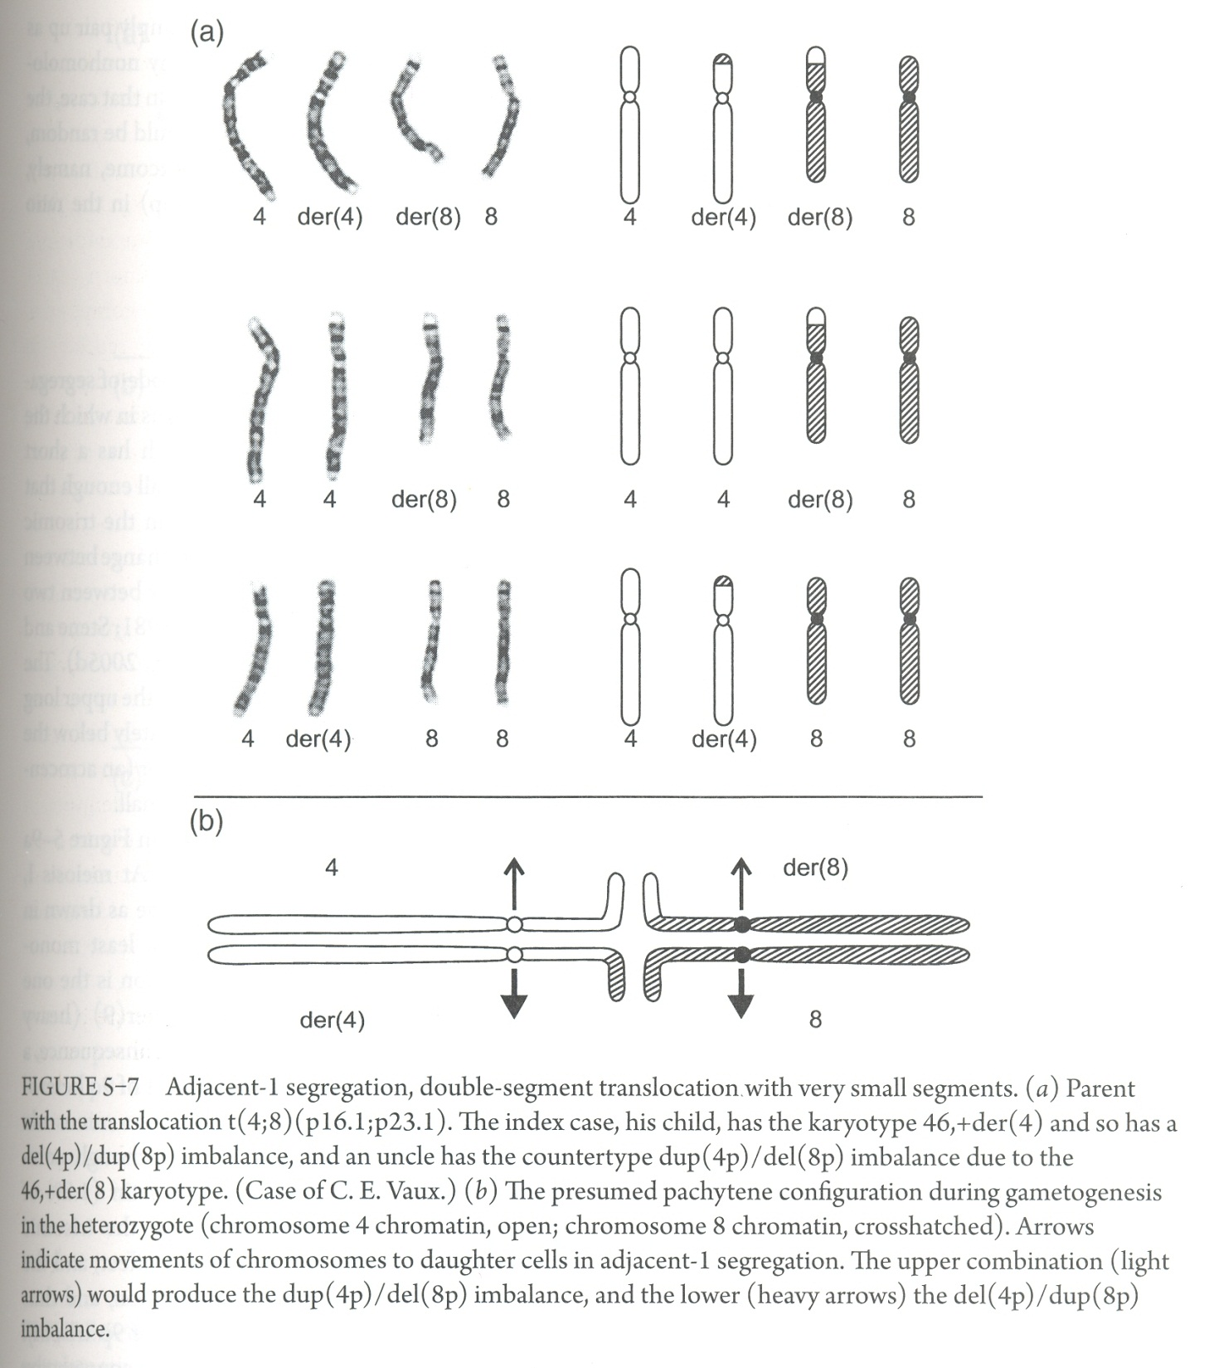
Adjacent-1 segregation, double-segment exchange
Imbalanced conceptus has both a partial trisomy and a partial monosomy (dup/del)
It is infrequent that the carrier of a “double-segment” exchange can ever have a chromosomally unbalanced pregnancy proceeding through to term
Uncle with dup(4p)/del(8p)
Index case with del(4p)/dup(8p)

Slide 14
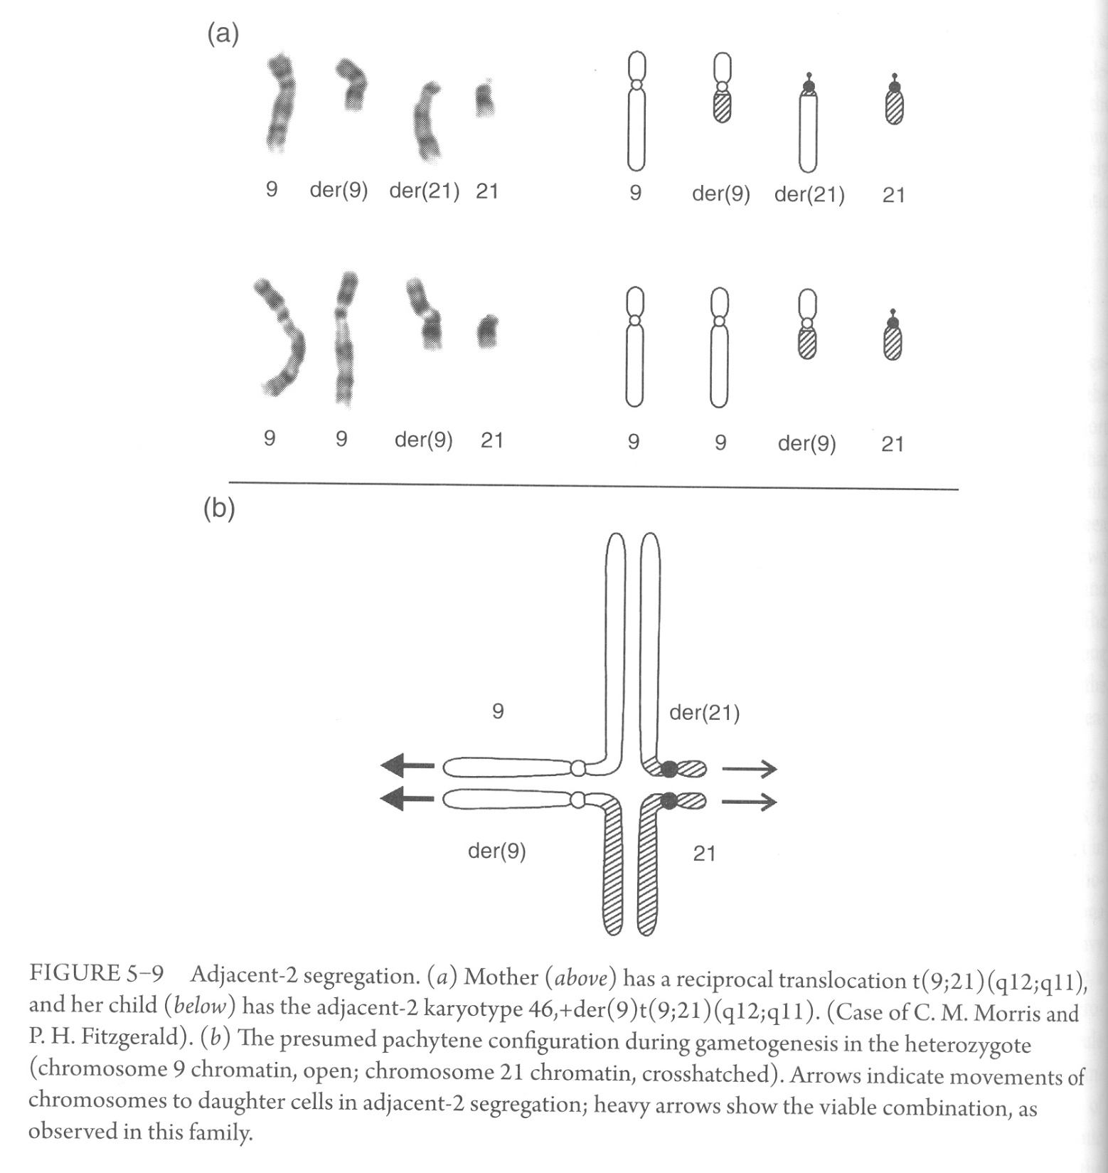
Adjacent-2 segregation
Each participant has a short arm of small genetic content, whole short arm viable in the trisomic state
Most involve chromosome 9 and an acrocentric, or two acrocentrics

Slide 15
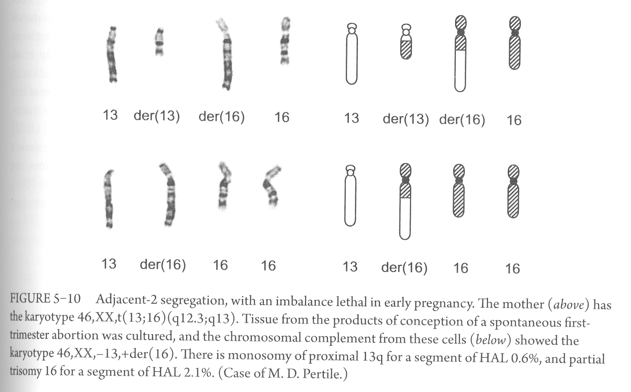
Few examples of adjacent-2 segregation are seen because most are lethal. The above karyotype is from a miscarriage

Slide 16
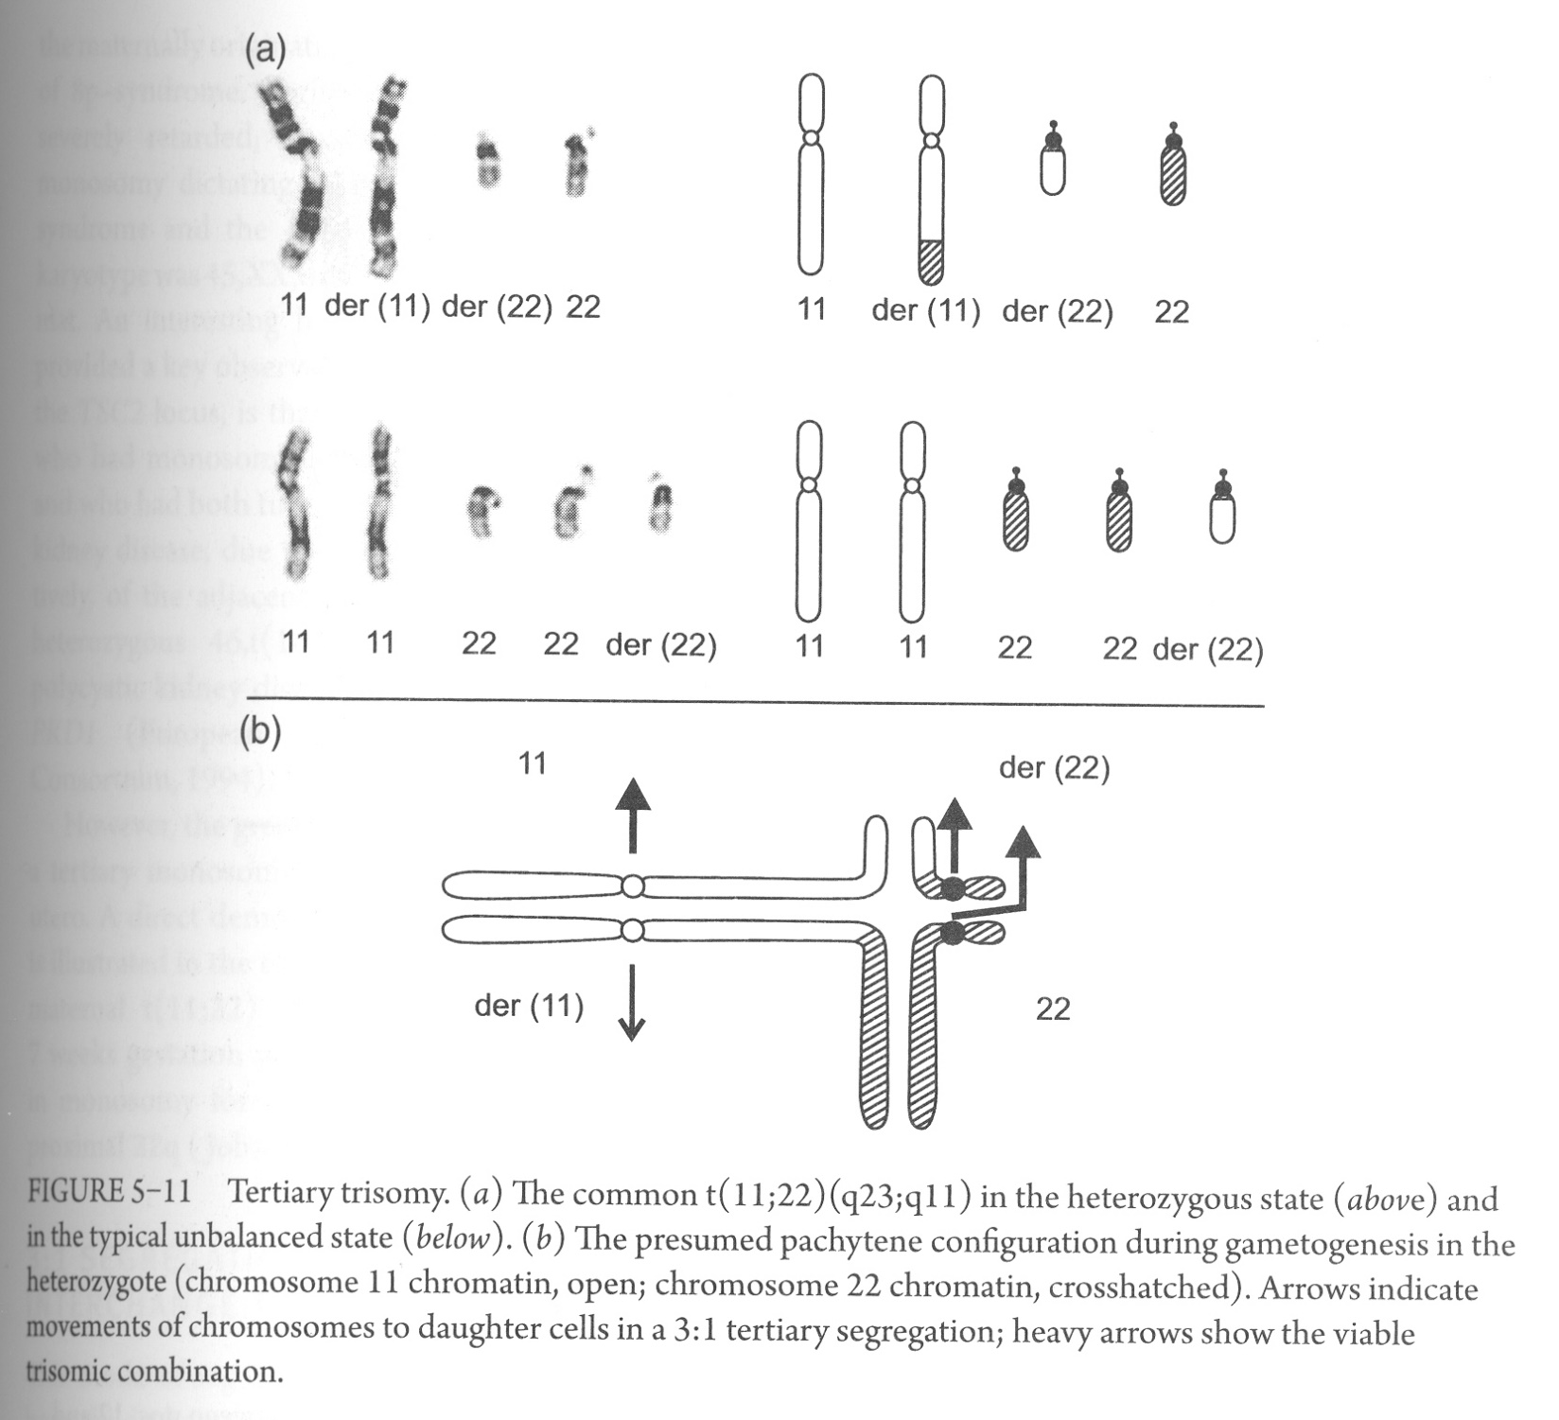
3:1 Segregation with tertiary trisomy
t(11;22) is the spectacular exception to the rule that, in different families, translocations arise at different sites
The great majority of families have a “private translocation”, and many may represent the first and only case in the whole of human evolution
May reflect a physical proximity between the two chromosomes during meiosis
Emanuel syndrome
The presence of this 47th chromosome does not necessarily impose a lethal distortion upon intrauterine development

Slide 17
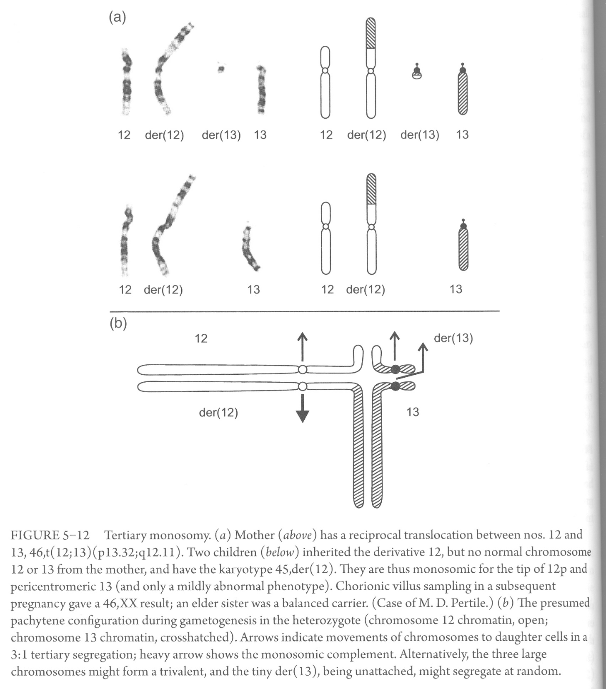
3:1 Segregation with tertiary monosomy
If one derivative is very small, and the amount of material that is missing is “monosomocally small”, the countertype 3:1 22-chromosome gamete may lead to a viable conceptus
The large derivative chromosome is not far from being a composite of the two complete chromosomes
However, the great majority of conceptions with a tertiary monosomy are expected to be lethal in utero

Slide 18
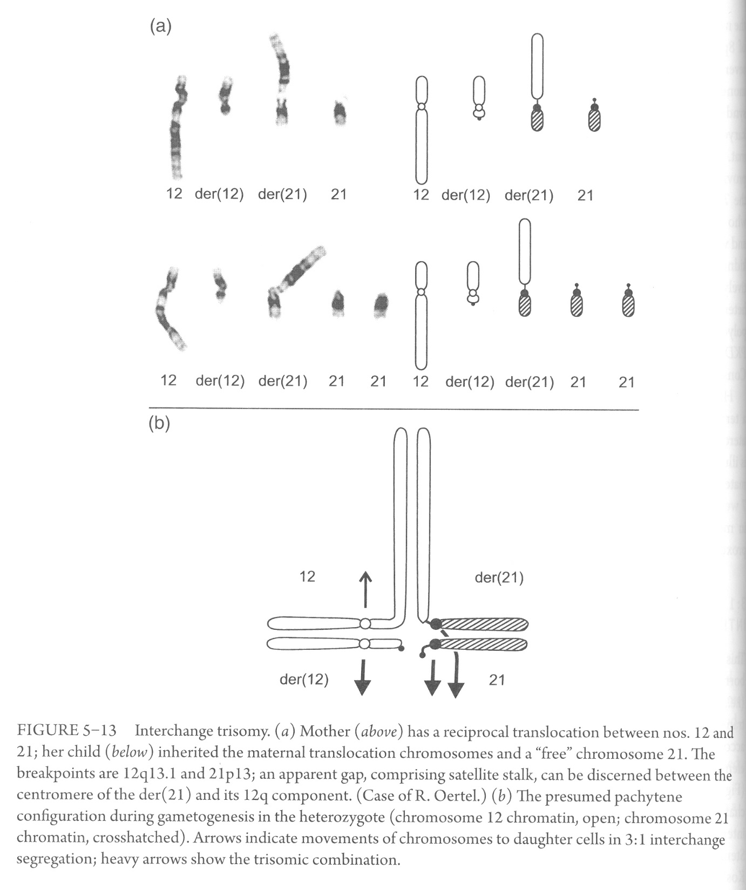
3:1 Segregation with interchange trisomy
This mode of segregation can only produce a live-born child when a “trisomically viable chromosome” (i.e. 13, 18, or 21) participate in the translocation

Slide 19
3:1 Segregation with interchange monosomy
Autosomal monosomy is typically associated with early arrested development
Only with PGD does a practical relevance possibly emerge
4:0 Segregation
Pre-implantation lethality would be the likely consequence
May be detected by PGD

Slide 20
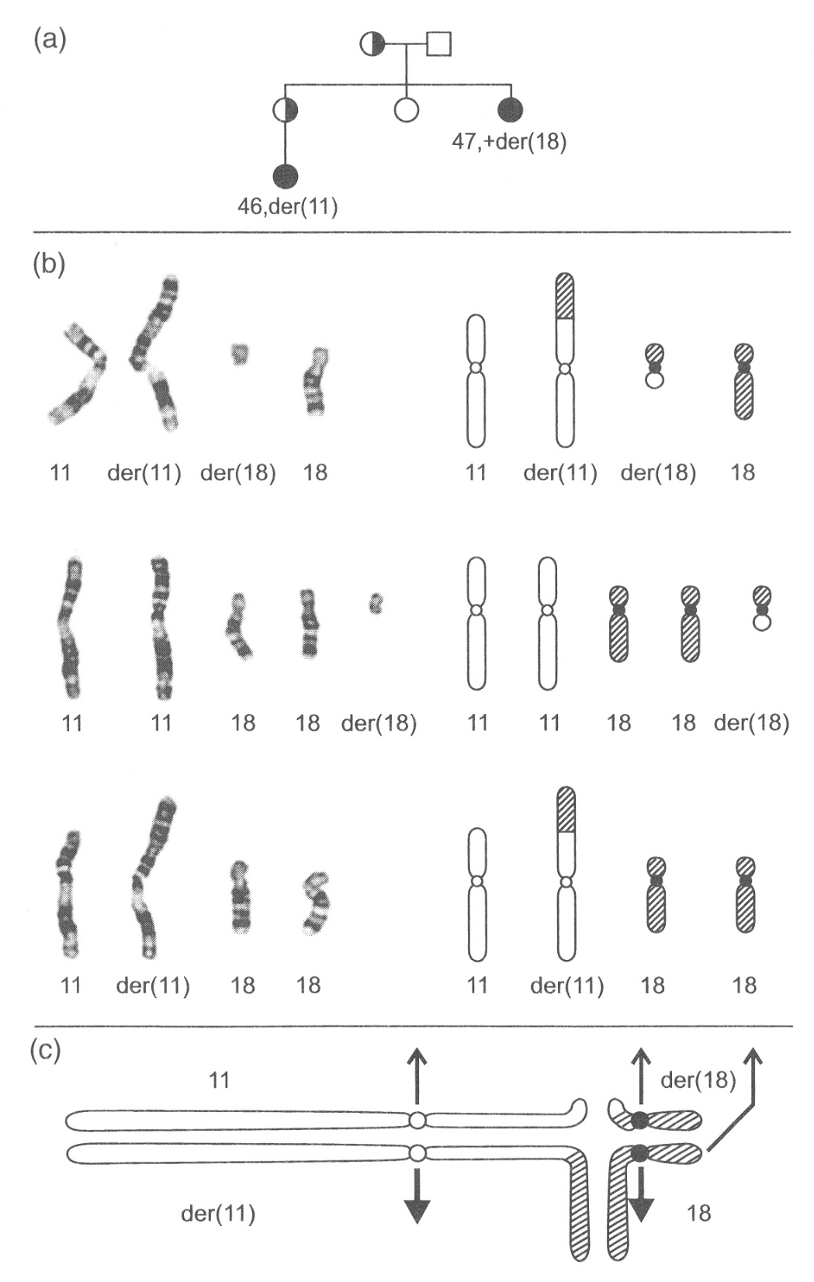
More than one unbalanced segregant type
This case is regarded a single-segment imbalance
Adjacent-1 segregation
3:1 tertiary trisomy
(3:1 interchange trisomy is also possible)

Slide 21
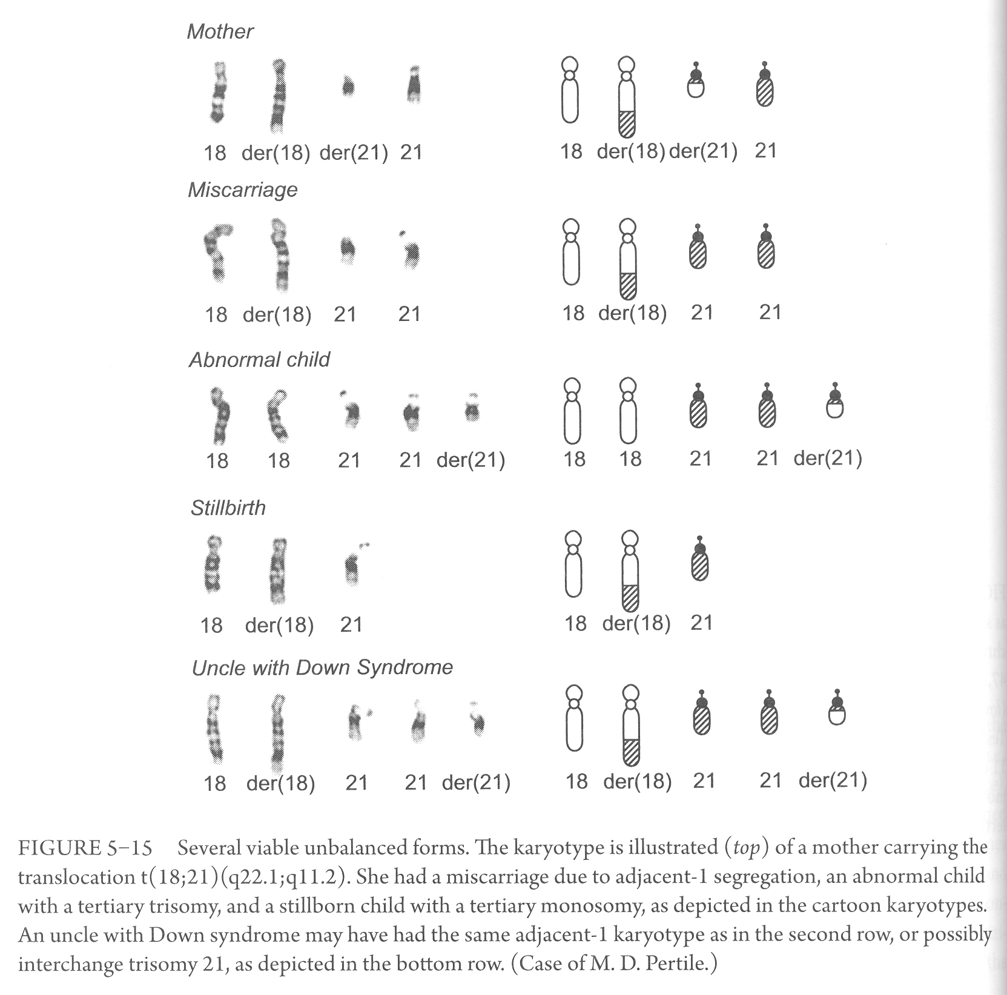
More than one unbalanced segregant type
Adjacent-1
Tertiary trisomy
Tertiary monosomy
Interchange trisomy

Slide 22
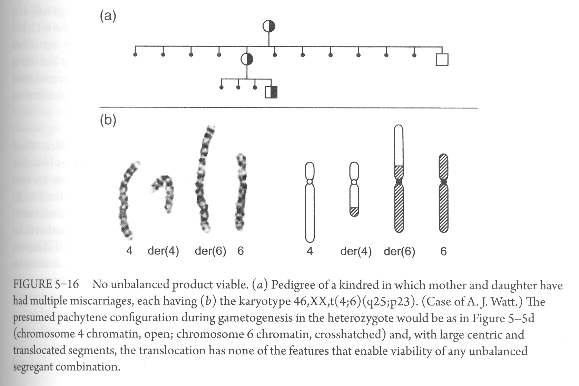
No unbalanced mode possible
Long translocated and long centric segments
>> no mode of segregation could produce a viable unbalanced outcome

